Slide 1
Lung Cancer Detection using CNN & Transfer Learning
A step-by-step walkthrough: dataset, preprocessing, models, training and results
Synthetic educational dataset – NOT real clinical scans, not for medical use
Notes:
Introduce the project: 3-class lung image classification comparing a scratch CNN with four ImageNet-pretrained backbones. Stress the synthetic-data disclaimer.

Slide 2
Project overview
Goal: classify 224×224 RGB images as normal, benign or malignant
Compare a CNN trained from scratch with four transfer-learning models
Judge every model on the same held-out test set with accuracy, precision, recall, F1, ROC-AUC and confusion matrix
Everything runs in one Colab notebook on a GPU runtime
3
classes
5
models compared
224×224
RGB input
Data is synthetic and for learning only. It must not be used for diagnosis, screening or treatment decisions.

Slide 3
The pipeline, step by step
1
2
3
4
5
6
Load data
Validate & explore
Preprocess
Build models
Train
Evaluate
Folders for train / validation / test
Structure checks, class counts, samples
Resize, scale per model, augment
Scratch CNN + 4 pretrained backbones
Two-phase transfer learning, callbacks
Metrics, ROC, confusion matrix, compare

Slide 4
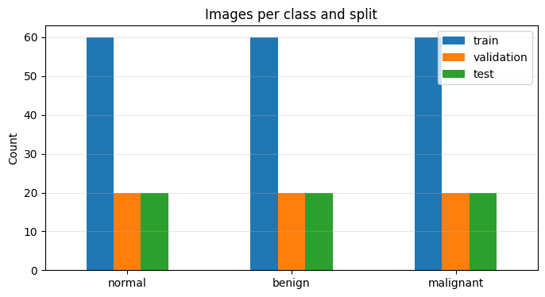
Dataset: what the notebook actually used
Split | Per class | Total
Train | 60 | 180
Validation | 20 | 60
Test | 20 | 60
All | 100 | 300
Heads-up: this run used a generated mini-dataset of 300 images (60 / 20 / 20 per class). The planned dataset had 5,400 images; the same code works unchanged once it is loaded. Classes are perfectly balanced, so no resampling was needed.

Slide 5
Data validation, cleaning & preprocessing
Structure check
Integrity
Balance
Asserts train / validation / test and all 3 class folders exist before anything runs
All 300 files loaded; counts match 180 / 60 / 60. Nothing corrupt, missing or dropped
60 / 20 / 20 images per class, so no resampling or class weights
Uniform format
Model-specific scaling
Augmentation
224×224 RGB, batches of 32, labels one-hot in a fixed order
0–1 for scratch CNN, mean-subtract for VGG16 / ResNet50, −1 to 1 for MobileNetV2, built-in for EfficientNet
Flip, rotation, zoom, translation. Training only; val and test are not shuffled

Slide 6
Five models compared
CNN Scratch
VGG16
ResNet50
MobileNetV2
EfficientNetB0
1.24M
14.85M
24.12M
2.59M
4.38M
total params
total params
total params
total params
total params
4 conv blocks + BatchNorm + Dropout. Baseline with no pretrained knowledge
Stacked 3×3 convolutions. Simple and reliable, but heavy
Residual skip connections allow very deep networks
Depthwise-separable convolutions. Light and fast
Compound scaling of depth, width and resolution
Transfer models share one head: Global Average Pooling → BatchNorm → Dropout → Dense(256) → Dropout → Softmax(3).

Slide 7
How the models were trained
Phase 1: train the head
Optimizer: Adam, loss: categorical cross-entropy
Batch size 32; scratch CNN up to 30 epochs
EarlyStopping on val_loss (patience 5), best weights restored
ReduceLROnPlateau (×0.3, patience 2)
ModelCheckpoint keeps the best model
Augmentation active only while training
Backbone frozen · learning rate 1e-3 · up to 12 epochs
Phase 2: fine-tune
Last 30 backbone layers unfrozen (BatchNorm stays frozen) · learning rate 1e-5 · up to 10 epochs

Slide 8
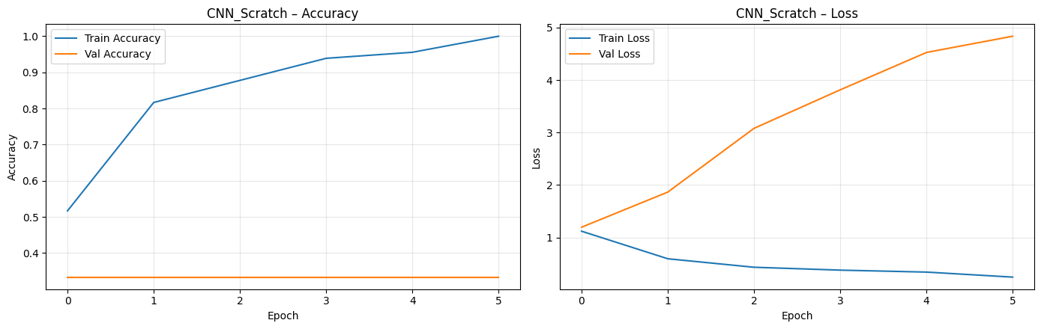
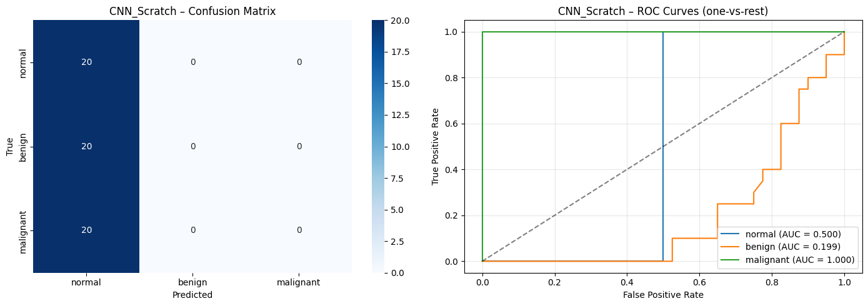
CNN from scratch
Test accuracy
33.3%
F1-score
0.167
ROC-AUC
0.567
Training time
0.3 min
It overfit: training accuracy reached 100% while validation stayed at 33% and validation loss rose from 1.2 to 4.8. Early stopping restored epoch 1. The model predicts "normal" for every test image.

Slide 9
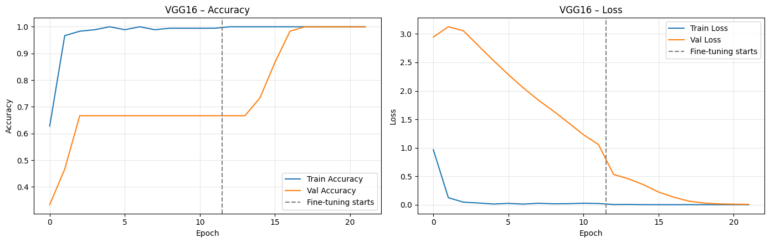
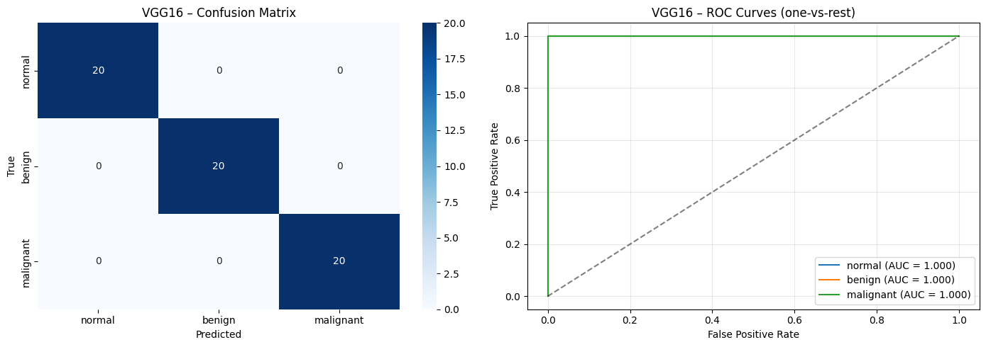
VGG16
Test accuracy
100%
F1-score
1.000
ROC-AUC
1.000
Training time
1.2 min
Phase 1 stalled at 67% validation accuracy. Fine-tuning in phase 2 lifted it to 100% by its sixth epoch. Every test image was classified correctly.

Slide 10
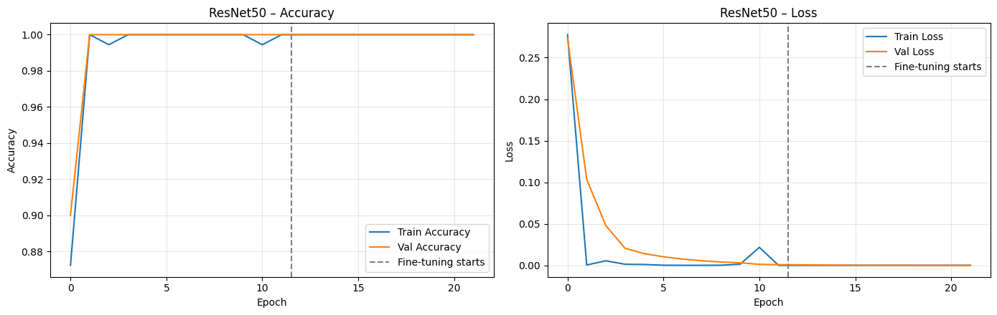

ResNet50
Test accuracy
100%
F1-score
1.000
ROC-AUC
1.000
Training time
1.8 min
Reached 100% validation accuracy in the second epoch of phase 1. The slowest model to train (24.1M parameters).

Slide 11
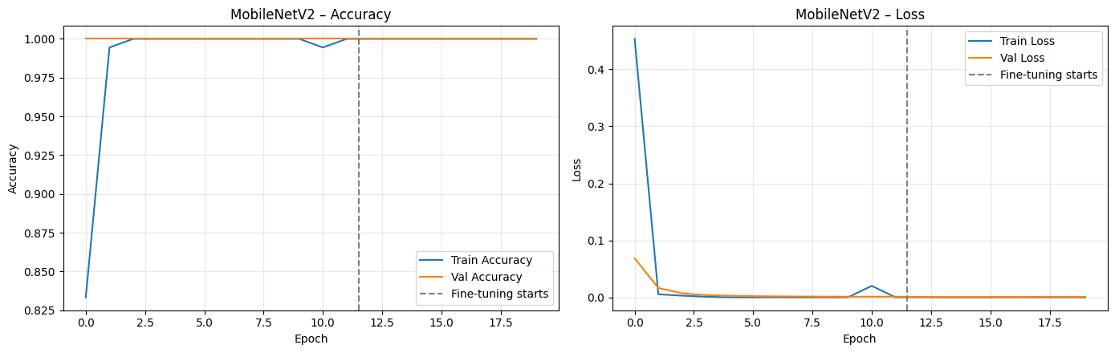

MobileNetV2
Test accuracy
100%
F1-score
1.000
ROC-AUC
1.000
Training time
0.7 min
100% validation accuracy from the first epoch. Early stopping ended phase 2 at epoch 8. Smallest transfer model at 2.6M parameters.

Slide 12
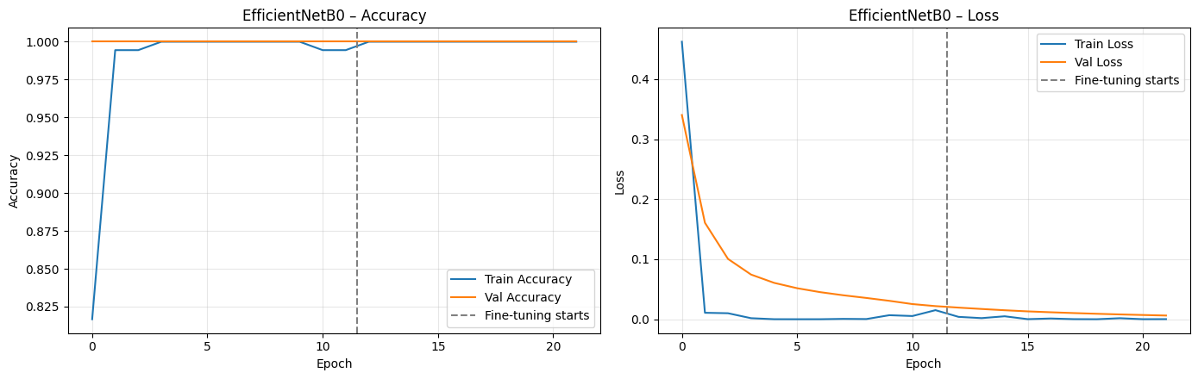

EfficientNetB0
Test accuracy
100%
F1-score
1.000
ROC-AUC
1.000
Training time
1.2 min
100% validation accuracy from the first epoch with 4.4M parameters, a good balance of size and accuracy.

Slide 13
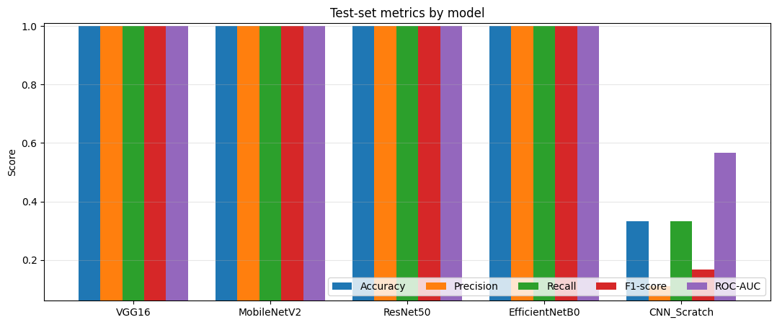
Model comparison on the test set
Model | Accuracy | Precision | Recall | F1 | ROC-AUC | Params (M) | Time (min)
CNN Scratch | 0.333 | 0.111 | 0.333 | 0.167 | 0.567 | 1.24 | 0.3
VGG16 | 1.000 | 1.000 | 1.000 | 1.000 | 1.000 | 14.85 | 1.2
ResNet50 | 1.000 | 1.000 | 1.000 | 1.000 | 1.000 | 24.12 | 1.8
MobileNetV2 | 1.000 | 1.000 | 1.000 | 1.000 | 1.000 | 2.59 | 0.7
EfficientNetB0 | 1.000 | 1.000 | 1.000 | 1.000 | 1.000 | 4.38 | 1.2
Four transfer models tie at a perfect score; the scratch CNN is far behind
The notebook picked VGG16 only because ties are sorted by name order
MobileNetV2 is the practical pick: 0.7 min and 2.6M parameters

Slide 14
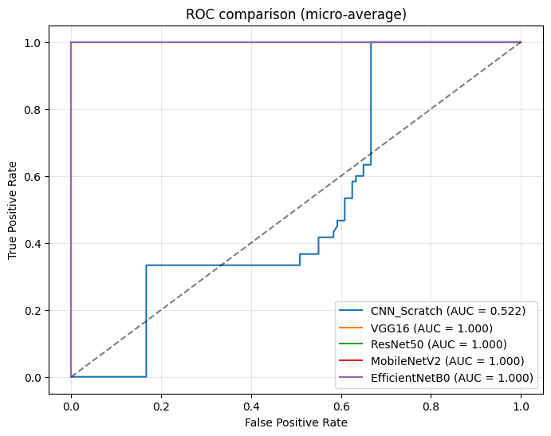
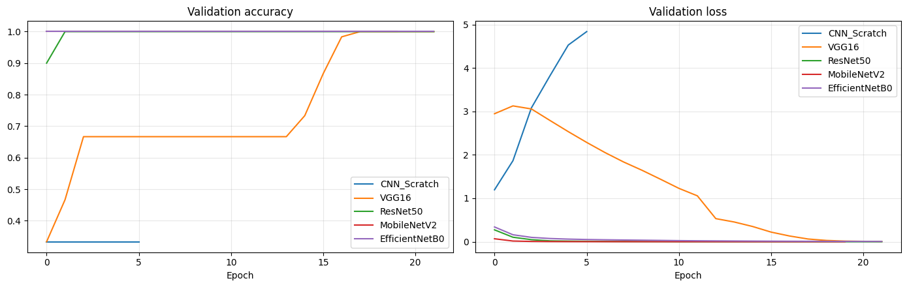
ROC and validation curves across models
Micro-averaged ROC: the four pretrained models sit on the top-left corner
Scratch CNN's validation loss climbs while the others fall toward zero
Pretrained ImageNet features learn much faster from only 180 training images

Slide 15
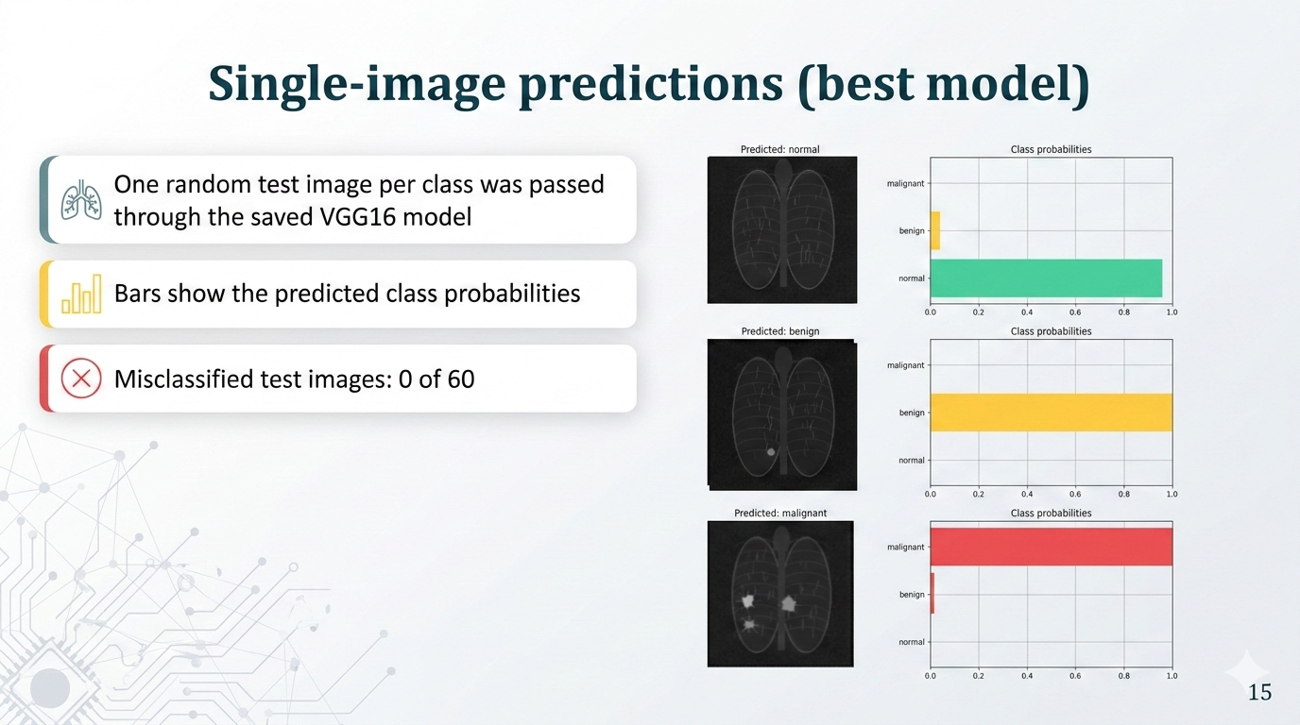

Slide 16
Key takeaways and caveats
What worked
Caveats
Next steps
Transfer learning beat the scratch CNN by a wide margin
Two-phase training with fine-tuning fixed VGG16's stalled phase 1
Early stopping stopped the scratch CNN from wasting epochs
Perfect scores on a 60-image test set are not a robust estimate
Synthetic nodules are easy to tell apart
Results would not carry over to real clinical images
Run on the full 5,400-image dataset
Add Grad-CAM, k-fold cross-validation and test-time augmentation
Tune learning rate and number of unfrozen layers

Slide 17
Conclusion
Pretrained backbones classified the synthetic images perfectly; a CNN from scratch could not learn from so little data.
Synthetic educational data only. These models must not be used for diagnosis, screening, treatment decisions or any medical purpose.

